Slide 1
Longest Circuit Problem
Pelinsu Çiftçioğlu 25204
Bora Mert Karal 24904
Deniz Küçükahmetler 24879
Mert Malaz 25321

Slide 2
Outline
Problem Description
Proving the Hardness of the Problem
Algorithm Description
Algorithm Analysis
Running Time Experimental Analysis
Correctness Experimental Analysis
Ratio Bound
Testing
Conclusion

Slide 3
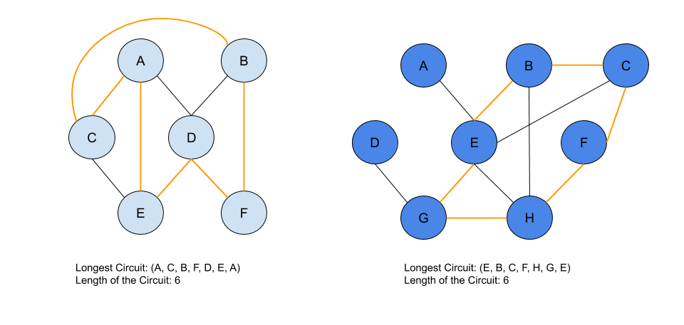
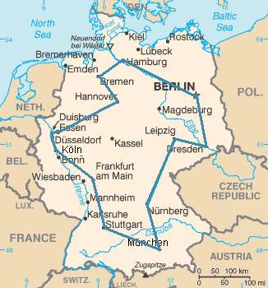
PROBLEM DESCRIPTION
Given an n-node undirected graph G(V,E), what is the length of a longest simple cycle in G?
Travelling Salesman

Slide 4
PROOF OF THE HARDNESS OF THE PROBLEM
Given an n-node undirected graph G(V,E) and a positive integer k, does G contain a simple cycle containing at least k nodes?
Longest Circuit Problem is NP-Complete
Polynomial Time Verifiable
Reducible in Polynomial Time to Another NP-Complete Problem

Slide 5
NP NP-Complete
Graph G(V, E), |V| = n,
Solution of vertices: <v₁, v₂, … , v_{k}>
Iterate over the graph for the solution set,
Check whether an edge connecting the vertices
🠚Path is tractable & Ends where it starts.
Polynomial Time Verifiability: O(k)
(Assuming that the locations of each vertex is known)
Hamiltonian Cycle: G = (V,E)
Simple cycle in the order <v1, v2, … , vn> of the vertices of G, where |V|= n,
such that (v_{n}, v₁) ∈ E, ∀ 1 ≤ i < n and (v_{i}, v_{i}+1) ∈ E.
Special Case of the Longest Circuit Problem:
Given an n-node undirected graph G(V,E) and a positive integer k, does G contain a simple cycle containing k = n nodes?

Slide 6
ALGORITHM DESCRIPTION
HeuristicLongestCircuit ( Graph=(V, E) )
A parent, visited, and cycles lists are created
Reset/Initialize parent and visited lists
Do a depth-first search with parent and visited lists, if a cycle exists proceed. Otherwise, go to step 2 and pick a new (clean) root.
Retrieve the beginning and the end of the cycle from depth-first search
Pop end vertex’s parents until root is reached to obtain the cycle
Add start of cycle to the end to form a cycle. Append the cycle to the cycles list. Go to step 2 if there are any vertices left.
Return the longest cycle in the cycles list

Slide 7
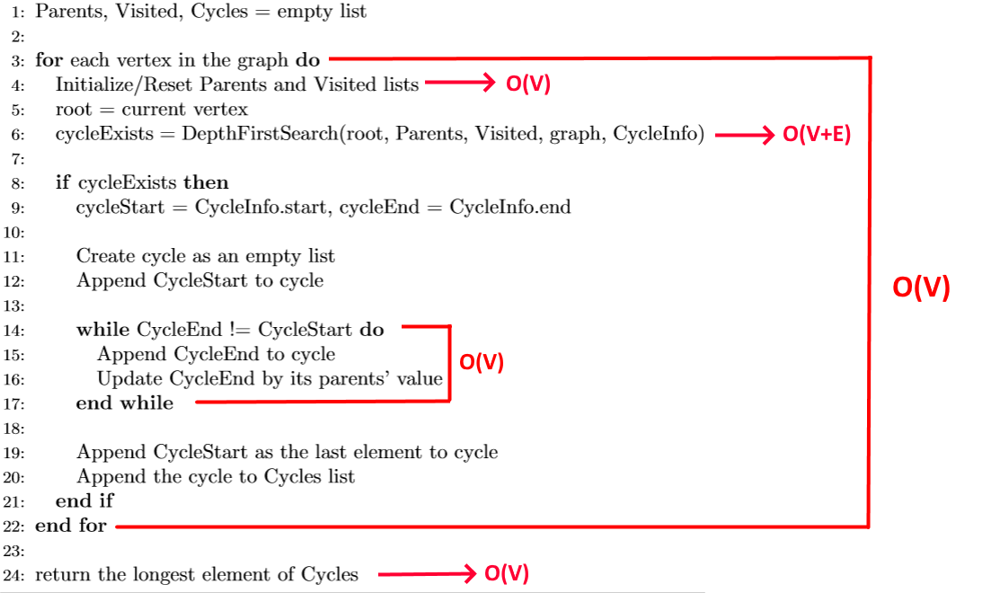
ALGORITHM ANALYSIS - Time Complexity
HeuristicLongestCircuit(graph)

Slide 8
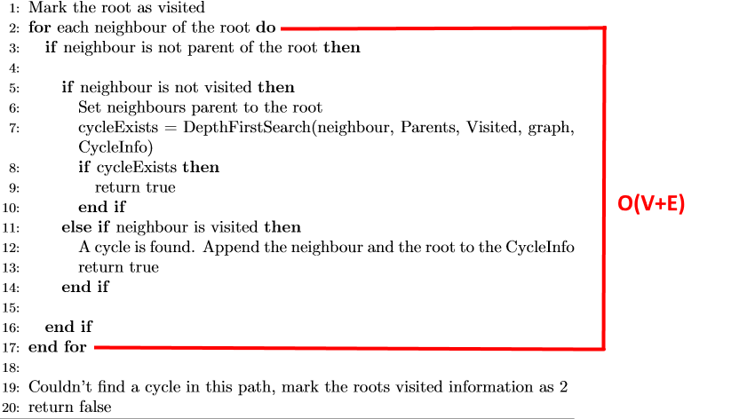
ALGORITHM ANALYSIS - Time Complexity
DepthFirstSearch(root, Parents, Visited, graph, CycleInfo)
What happens if the number of edges gets to its maximum value?

Slide 9
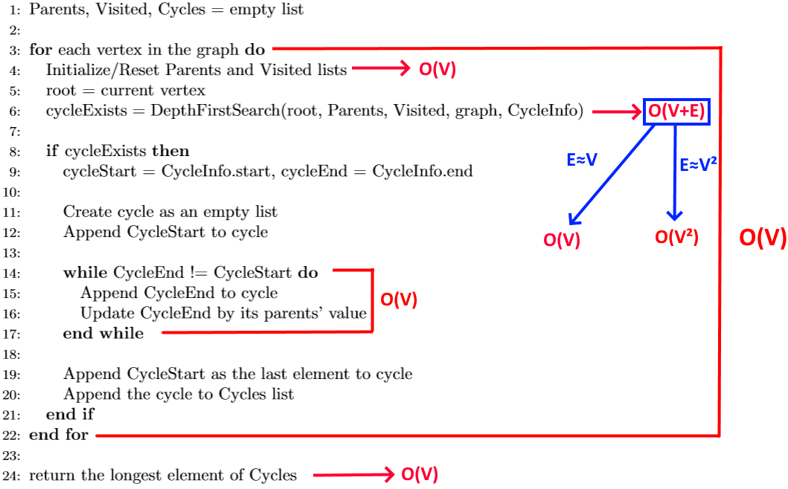
ALGORITHM ANALYSIS - Time Complexity
In a simple graph, a vertex can have at most V-1 edges.
Therefore |E| = O(V²)
O(V) + O(V² * V) = O(V³)

Slide 10
ALGORITHM ANALYSIS - Space Complexity
Input
Graph: O(V * E) = O(V³)
Auxiliary Space
The parent information: O(V)
Visited/Not visited information: O(V)
Last found cycle: O(V+1)
A list to hold all of the cycles: O(V * (V+1)) = O(V²)
Space Complexity
O(V³)

Slide 11
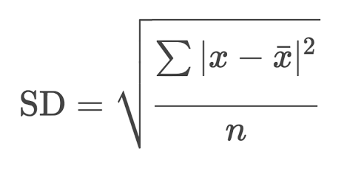

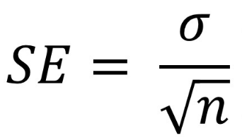


RUNNING TIME EXPERIMENTAL ANALYSIS
Algorithm implemented in Python3
Standard deviation and standard error is found
Confidence interval is computed
Kept number of edges constant (E=200)
Number of vertices: range(50, 1000, 50)
Kept number of vertices constant (V=200)
Number of edges: range(50, 1000, 50)
Number of samples : 100, 500, 1000
Results are visualized

Slide 12
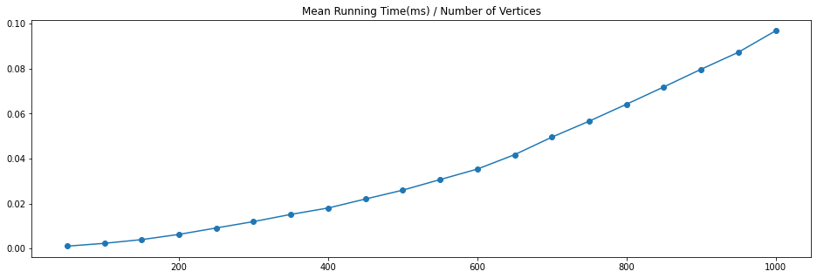
(# of Samples, # of Edges) = (1000, 200)

Slide 13
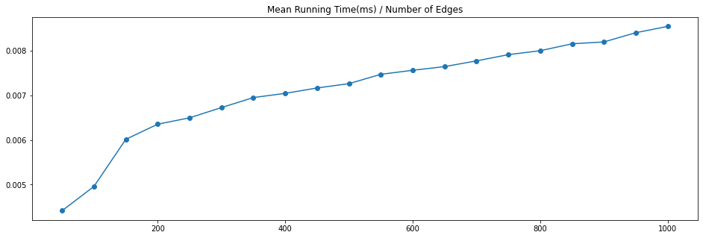
(# of Samples, # of Vertices) = (1000, 200)

Slide 14
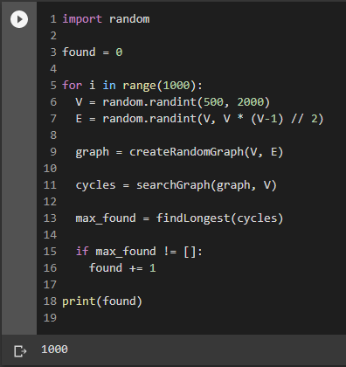
CORRECTNESS EXPERIMENTAL ANALYSIS
Algorithm is heuristic
Successfully terminates for acyclic graphs
Otherwise, finds a candidate for the longest simple cycle
1000 random graphs
V = random(500, 2000)
E = random(V, V * (V - 1) / 2)

Slide 15
Ratio Bound
Random graphs were created with maximum number of 10 vertices and 10 edges
Brute force and heuristic algorithm is used to find the ratio bound as:
Ratio Bound = size(Optimum Longest Cycle)/ size(Longest Cycle Found by Heuristic Algorithm)
Not feasible to find for graphs with more vertices/edges

Slide 16
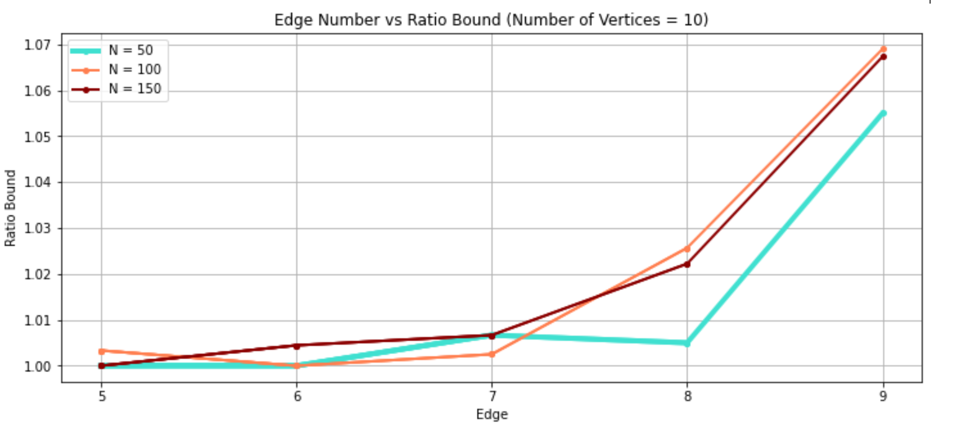
Vertex Number Constant
Ratio bound is lower for sparse graphs

Slide 17
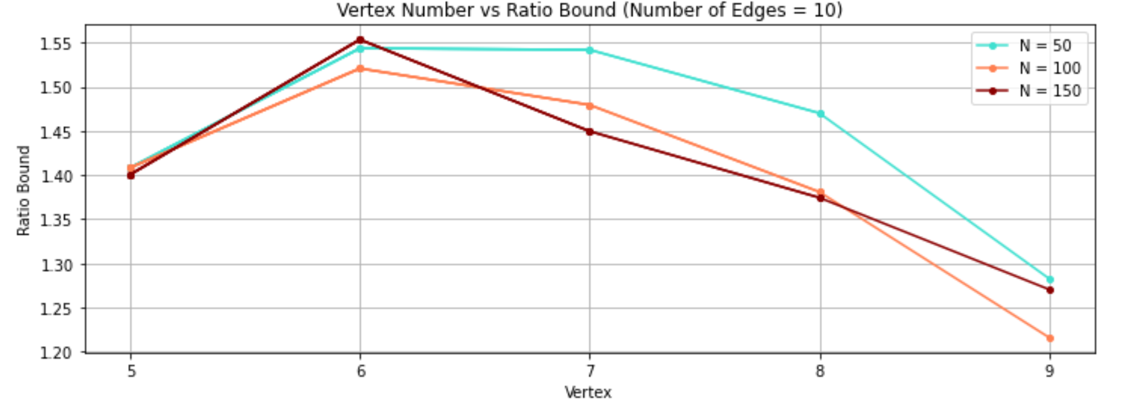
Edge Number Constant
Overall trend shows the ratio bound gets closer to 1 as the graphs with density decrease

Slide 18
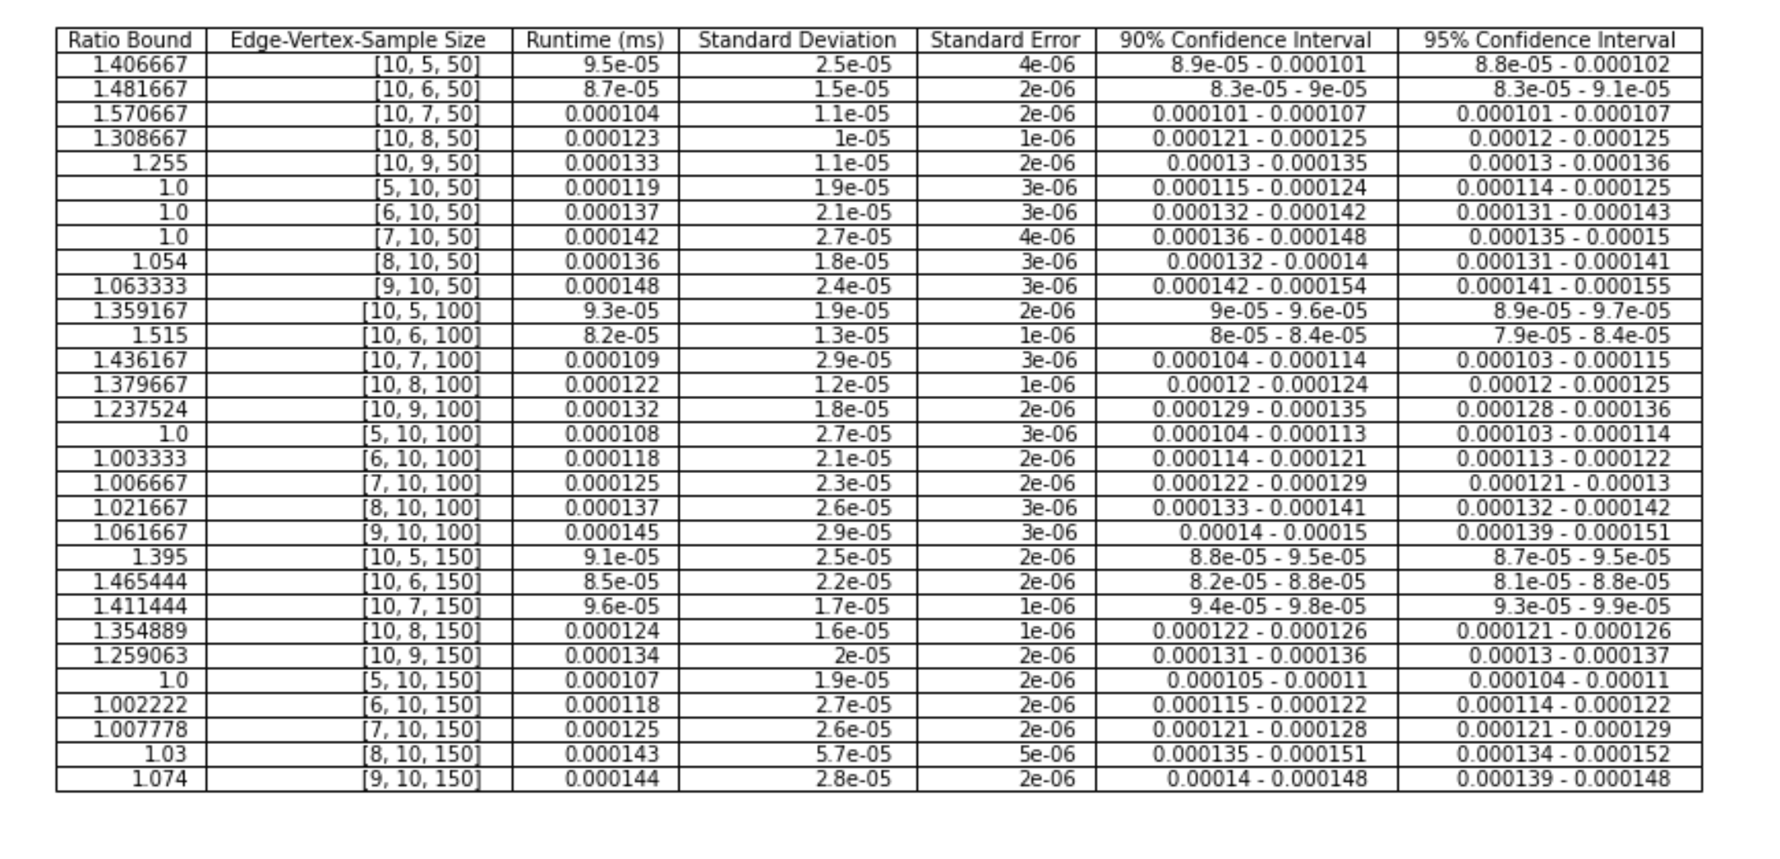
Statistical Tests with the Ratio Bound

Slide 19
TESTING
Black box testing
Heuristic algorithm output was compared to the brute force algorithm output
Edge cases were tried:
Disconnected graphs
Graphs with more than one cycle
Density increase
Again, not feasible to try bigger graphs

Slide 20
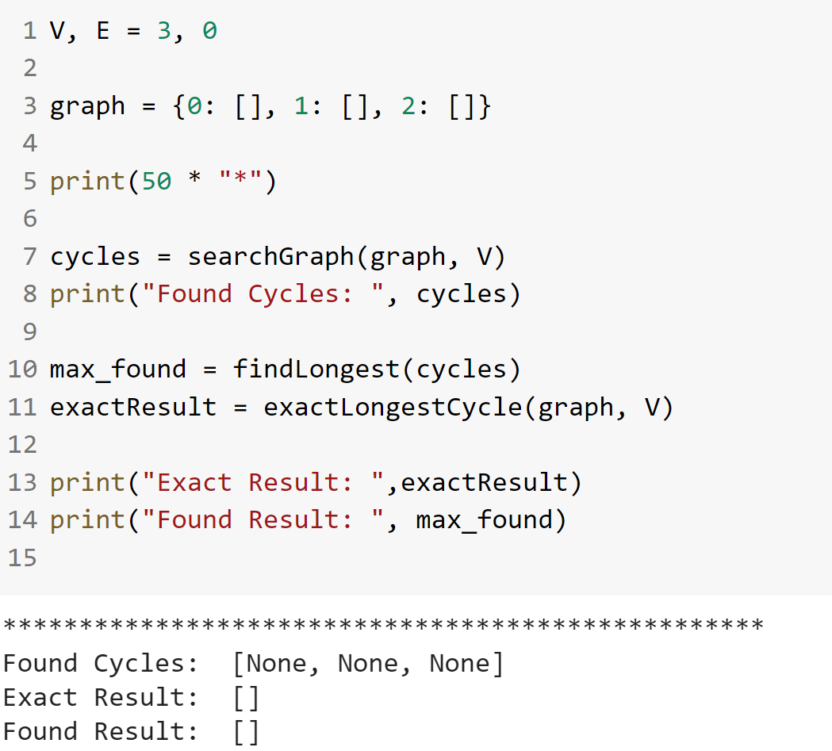
Disconnected, No Cycles
A
B
C
Length found by heuristic = 0
SUCCEEDED

Slide 21
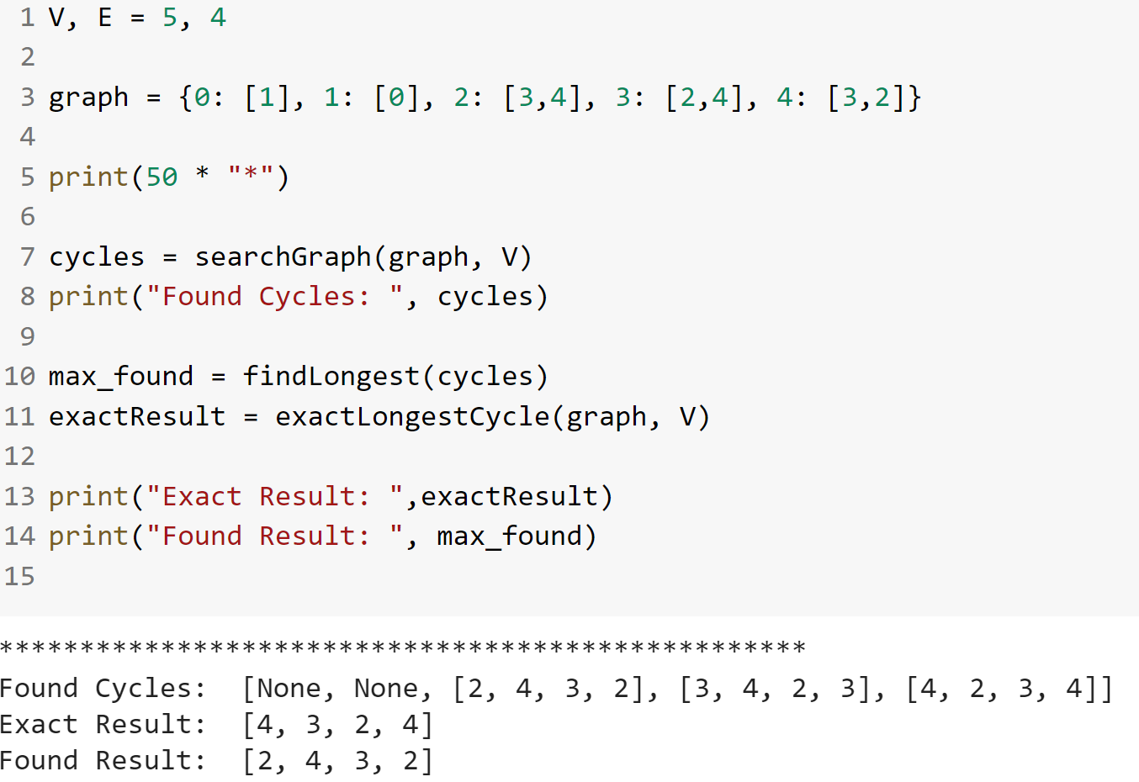
Disconnected, with Cycles
A
C
D
B
D
Length found by heuristic = 3
SUCCEEDED

Slide 22
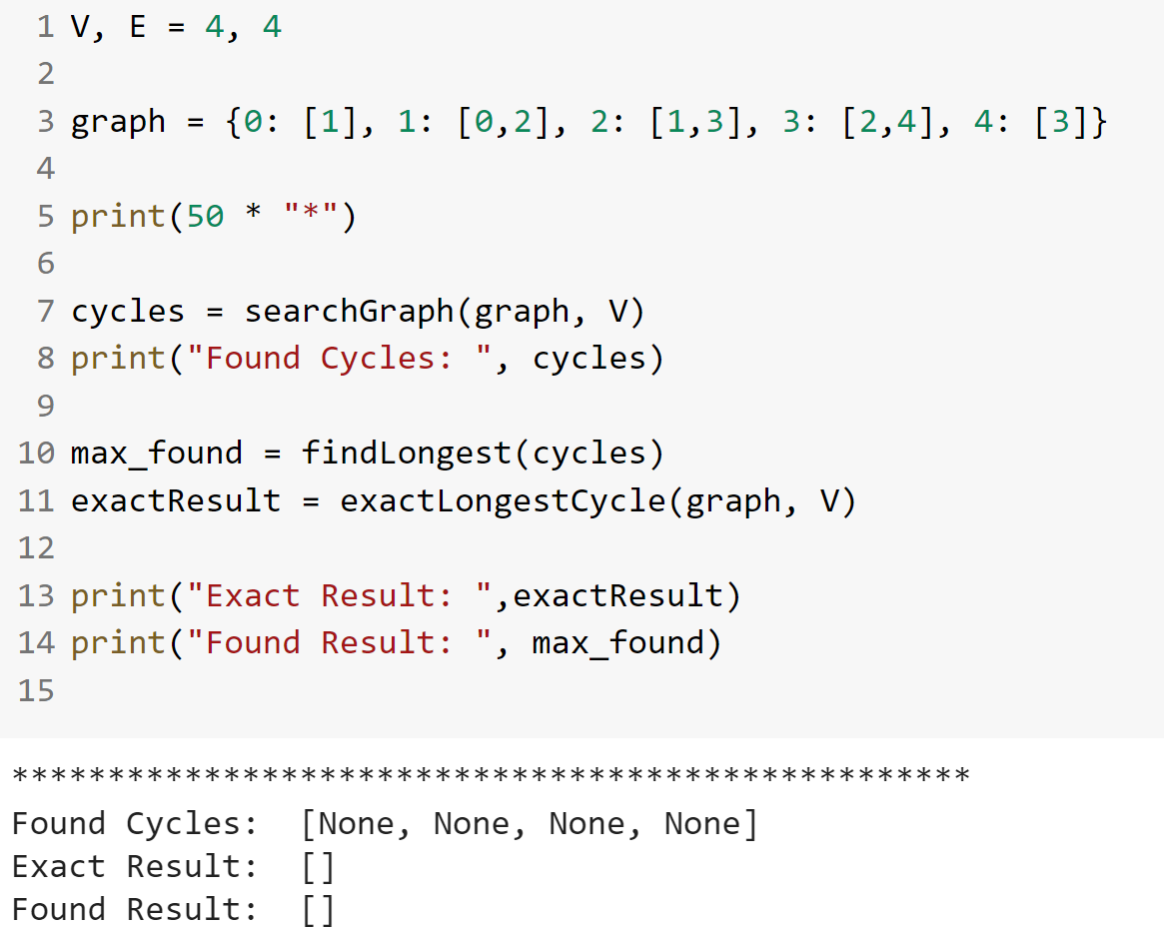
Connected, No Cycles
C
D
E
B
A
Length found by heuristic = 0
SUCCEEDED

Slide 23
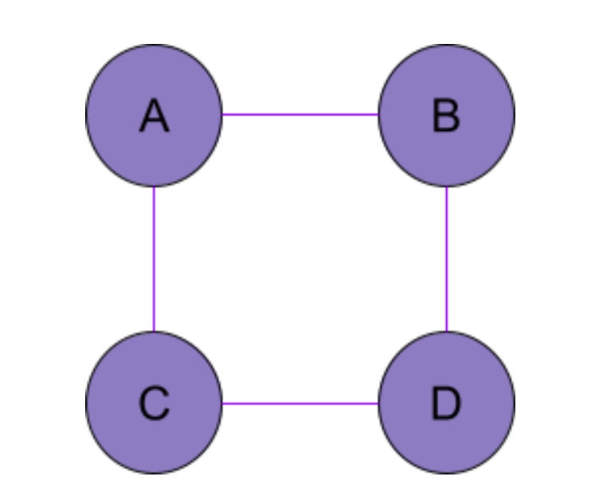
Includes 1 cycle, 4 edges 4 vertices
Length of the cycle = 4
SUCCEEDED

Slide 24
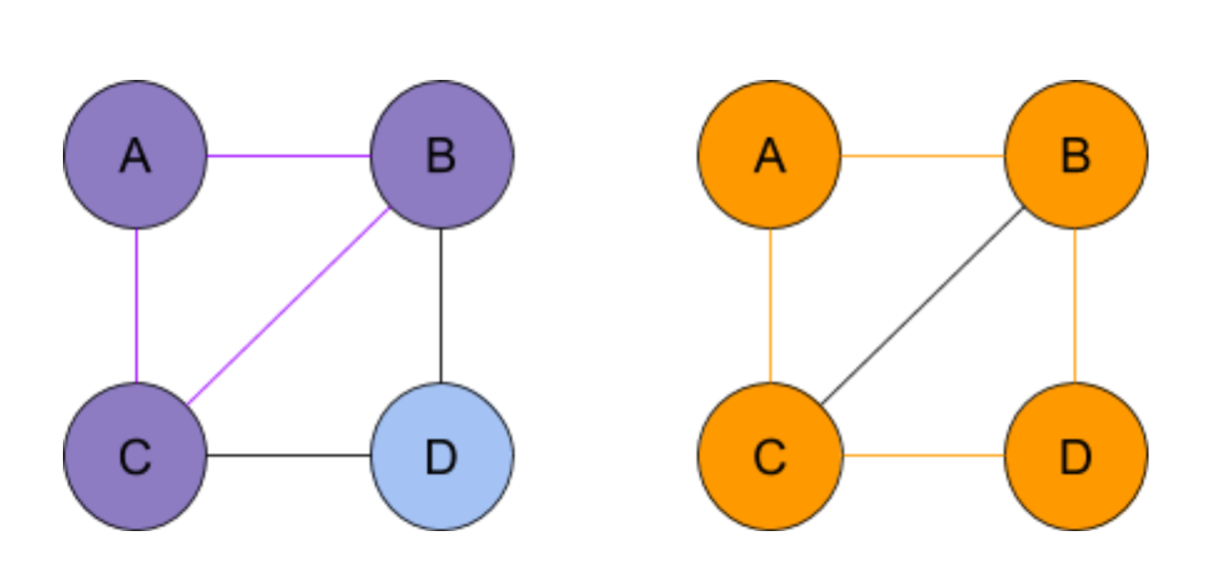
Increasing the Density
Length found by heuristic= 3 Length found by brute force = 4
FAILED

Slide 25
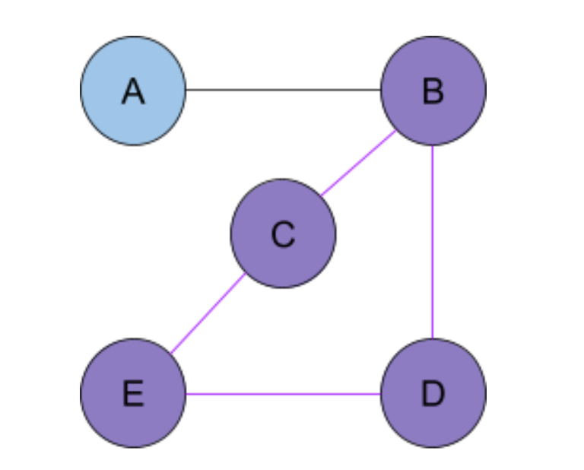
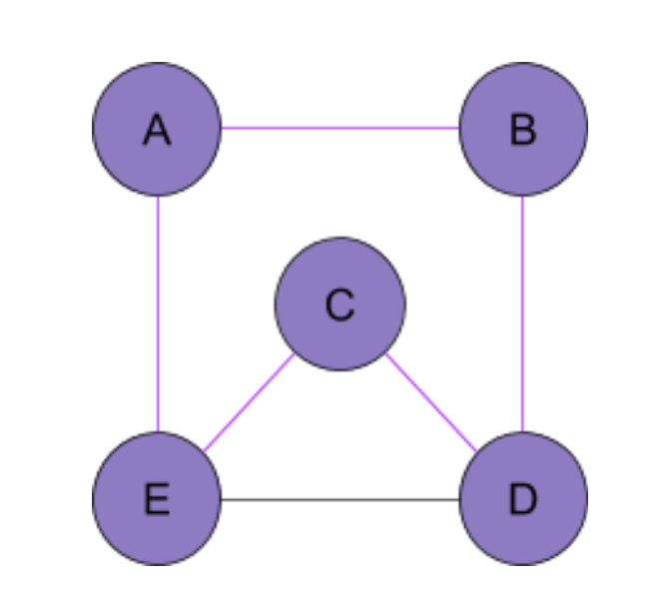
5 Vertices with 5 and 6 Edges
Length found by heuristic= 4 Length found by brute force = 5
SUCCEEDED
SUCCEEDED

Slide 26
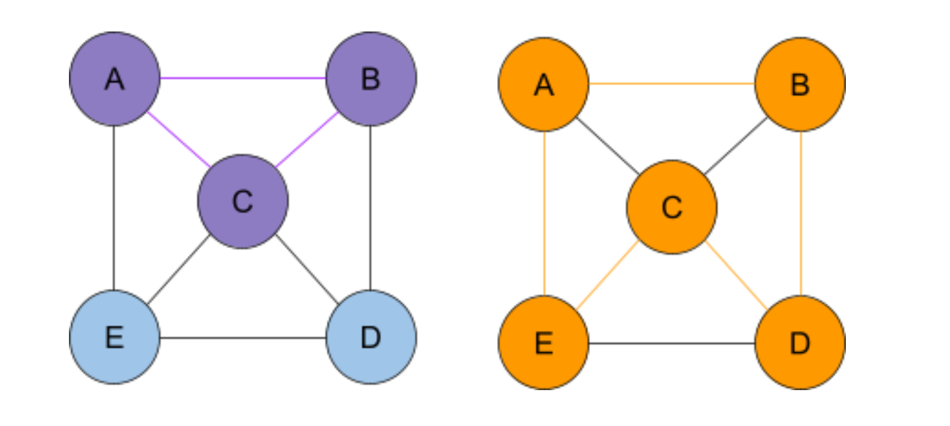
Increasing the Density
Length found by heuristic= 3 Length found by brute force = 5
FAILED

Slide 27
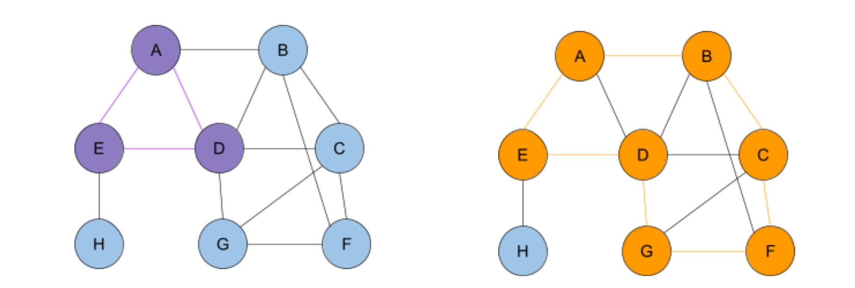
Length found by heuristic= 3 Length found by brute force = 7
FAILED

Slide 28
Conclusion
Longest Circuit is NP-Complete as it is polynomial time verifiable and reducible to Hamiltonian cycle problem.
Time complexity of O(V³) and space complexity of O(V³)
The heuristic algorithm observed to work better for sparse graphs.
Experimentally it runs polynomial when E is constant, linear when V is constant.
It can produce meaningful answers to the LSC problem.

Slide 29
References
Hüsnü Yenigün, Fall 2020, Lecture Slides, CS301-Algorithms-08-NP-Completeness.pdf
https://en.wikipedia.org/wiki/Travelling_salesman_problem#:~:text=The%20travelling%20salesman%20problem%20
An Annotated List of Selected NP-complete Problems, https://cgi.csc.liv.ac.uk/~ped/teachadmin/COMP202/annotated_np.html
University of California San Diego, https://cseweb.ucsd.edu/classes/fa98/cse101/hw3ans/hw3ans.html
CP-AlgorithmsPage Authors, https://cp-algorithms.com/graph/finding-cycle.html

